Slide 1
DSE ZG523 Introduction to Data Science
Lecture – 15 & 16
Sumita Narang

Slide 2
Objectives
Bias and Fairness
Types of Bias
Identifying Bias
Evaluating Bias
Being a data skeptic – examples of misuse of Data
Doing Good Science
Five C’s
Ethical guidelines for Data Scientist
Ethics of data scraping and storage
Case Study: IBM AI Fairness 360

Slide 3
What are Ethics
Ethics tells us about right and wrong
They are shared value / societal rule
Ethic is not law
No philosophical questions, but ethical practice of Data Science

Slide 4
Bias and Fairness
Hidden Biases in Big Data - https://hbr.org/2013/04/the-hidden-biases-in-big-data
Data and data sets are not objective; they are creations of human design. We give numbers their voice, draw inferences from them, and define their meaning through our interpretations. Hidden biases in both the collection and analysis stages present considerable risks, and are as important to the big-data equation as the numbers themselves.
For example, consider the Twitter data generated by Hurricane Sandy, more than 20 million tweets between October 27 and November 1. A fascinating study combining Sandy-related Twitter and Foursquare data produced some expected findings (grocery shopping peaks the night before the storm) and some surprising ones (nightlife picked up the day after — presumably when cabin fever strikes). But these data don’t represent the whole picture. The greatest number of tweets about Sandy came from Manhattan. This makes sense given the city’s high level of smartphone ownership and Twitter use, but it creates the illusion that Manhattan was the hub of the disaster. Very few messages originated from more severely affected locations, such as Breezy Point, Coney Island and Rockaway. As extended power blackouts drained batteries and limited cellular access, even fewer tweets came from the worst hit areas. In fact, there was much more going on outside the privileged, urban experience of Sandy that Twitter data failed to convey, especially in aggregate. We can think of this as a “signal problem”: Data are assumed to accurately reflect the social world, but there are significant gaps, with little or no signal coming from particular communities.
But as we increasingly rely on big data’s numbers to speak for themselves, we risk misunderstanding the results and in turn misallocating important public resources. This could well have been the case had public health officials relied exclusively on Google Flu Trends, which mistakenly estimated that peak flu levels reached 11% of the US public this flu season, almost double the CDC’s estimate of about 6%. While Google will not comment on the reason for the overestimation, it seems likely that it was caused by the extensive media coverage of the flu season, creating a spike in search queries.

Slide 5
Being a data skeptic 1/
Skeptic, Not Cynic-
A skeptic is someone who maintains a consistently inquisitive attitude toward facts, opinions, or (especially) beliefs stated as facts. A skeptic asks questions when confronted with a claim that has been taken for granted. A really excellent skeptic puts the “science” into the term “data science.”
If you’ve seen the phrase “if it’s not measured, it doesn’t exist” one too many times used in a non-ironic, unthoughtful way, or even worse if you’ve said that phrase in a moment of triumphant triviality, you need to cast a skeptical eye on how math and data are used in business.
On Being a Data Skeptic

Slide 6
Being a data skeptic 2/
The Audience - technical aspects of data science are often presented as an impenetrable black box to business folks, intentionally or not. Fancy terminology can seem magical, or mumbo-jumbo can seem hyped, useless, and wasteful. The nontechnical audience must ask more and more probing questions from data folk, get them more involved, and tone down the marketing rhetoric.
People must find a way to bridge the gap between dialects—marketing or business-speak and math or engineering—so that both sides are talking and both sides are listening.

Slide 7
Being a data skeptic 2/
Trusting Data Too Much - 4 main concerns when it comes to the interface of business management and numbers and update them to the realm of big data:
1) People Get Addicted to Metrics: We believe in math because it’s “hard” and because it’s believed to be “objective” and because mathematicians are generally considered trustworthy, being known to deal in carefully considered logical arguments based on assumptions and axioms. Once we start seeing mathematical models as trustworthy tools, we get into the habit of measuring things more and more in order to control and understand them. This is not in itself a bad thing. But it can quickly become a form of addiction—especially if we only acknowledge things that are measurable and if we hunger to fit everything into the data box.
For example, let’s think about how this data-addicted mindset is blind to certain phenomena. If we want to keep something secret, out from under the control of the data people, we only need to keep those things out of the reach of sensors or data-collection agents.
Even when we have some measurement of something, it doesn’t mean that it’s a clean look. Sales data varies from month to month, and sometimes it’s predictable and sometimes it isn’t. Not all data is actionable and not all “hard” numbers are definitive.

Slide 8
Being a data skeptic 3/
2) Too Much Focus on Numbers, Not Enough on Behaviors- Because of the sanitizing effect of mathematical modeling, we often interpret the results of data analysis as “objective” when it’s of course only as objective as the underlying process and relies in opaque and complex ways on the chosen proxies. The result is a putatively strong, objective measure that is actually neither strong nor objective. This is sometimes referred to as the “garbage in garbage out” problem.
Examples: First, let’s talk about the problem of selection bias. Even shining examples of big data success stories like Netflix’s movie recommendation system suffer from this, if only because their model of “people” is biased toward people who have the time and interest in rating a bunch of movies online—this is putting aside other modeling problems Netflix has exhibited, such as thinking anyone living in certain neighborhoods dominated by people from Southeast Asia are Bollywood fans, as described by DJ Patil.
When credit rating agencies gave AAA ratings to crappy mortgage derivatives, they were using extremely weak proxies. Specifically, when new kinds of mortgages like the no-interest, no-job “NINJA” mortgages were being pushed onto people, packaged, and sold, there was of course no historical data on their default rates. The modelers used, as a proxy, historical data on higher quality mortgages instead. The models failed miserably.

Slide 9
Being a data skeptic 4/
3) People Frame the Problem Incorrectly - The first stage in doing data science is a translation stage. Namely, we start with a business question and we translate it into a mathematical model. But that translation process is not well-defined: we make lots of choices, sometimes crucial ones.
How do we measure a company, for example? By the revenue, the profit, or the number of people it employs? Do we measure its environmental impact? What is considered “progress” in this context?
Another way things could go wrong: the problem could even be relatively well-defined but then the evaluation of the solution could be poorly chosen. Choosing an evaluation metric is tricky business and by all accounts should be considered part of a model
For example - about proxies in the realm of advertisers and click-through rates. “did that person buy the product after clicking on the ad?”

Slide 10
Being a data skeptic 5/
4) People Ignore Perverse Incentives - Models, especially high-stake models where people’s quality of life is on the line, beg for gaming, as we’ve seen time and time again.
So for example, the FICO credit score model is pretty good on the spectrum of gamability. We know that to increase our credit score, we should pay our bills on time, for example. In fact most people wouldn’t even call that gaming.

Slide 11
Doing Good Science
R2 – Chapter 1
https://www.ebooks.com/en-us/book/209925972/ethics-and-data-science/mike-loukides/
There has been a lot of healthy discussion about data ethics lately. We want to be clear: that discussion is good, and necessary. But it’s also not the biggest problem we face. We already have good stand‐ ards for data ethics.
The ACM’s code of ethics<http://bit.ly/2zUY4E7>, which dates back to 1993, and is currently being updated, is clear, concise, and surpris‐ ingly forward-thinking; 25 years later, it’s a great start for anyone thinking about ethics.
The American Statistical Association<http://bit.ly/2mzaMPw> has a good set of ethical guidelines for working with data. So, we’re not working in a vacuum.

Slide 12
Five C’s
R2 – Chapter 3
Consent
Clarity
Consistency and Trust
Control and Transparency
Consequences

Slide 13
Ethics of data scraping and storage
https://towardsdatascience.com/ethics-in-web-scraping-b96b18136f01
The Ethical Scraper
I, the web scraper will live by the following principles:
If you have a public API that provides the data I’m looking for, I’ll use it and avoid scraping all together.
I will always provide a User Agent string that makes my intentions clear and provides a way for you to contact me with questions or concerns.
I will request data at a reasonable rate. I will strive to never be confused for a DDoS attack.
I will only save the data I absolutely need from your page. If all I need it OpenGraph meta-data, that’s all I’ll keep.
I will respect any content I do keep. I’ll never pass it off as my own.
I will look for ways to return value to you. Maybe I can drive some (real) traffic to your site or credit you in an article or post.
I will respond in a timely fashion to your outreach and work with you towards a resolution.
I will scrape for the purpose of creating new value from the data, not to duplicate it.

Slide 14
Ethics of data scraping and storage 2/
The Ethical Site Owner
I, the site owner will live by the following principles:
I will allow ethical scrapers to access my site as long as they are not a burden on my site’s performance.
I will respect transparent User Agent strings rather than blocking them and encouraging use of scrapers masked as human visitors.
I will reach out to the owner of the scraper (thanks to their ethical User Agent string) before blocking permanently. A temporary block is acceptable in the case of site performance or ethical concerns.
I understand that scrapers are a reality of the open web.
I will consider public APIs to provide data as an alternative to scrapers.

Slide 15
Case Study 1: IBM AI Fairness 360 - Detecting and mitigating age bias on credit decisions
Credit Decisions - https://nbviewer.jupyter.org/github/IBM/AIF360/blob/master/examples/tutorial_credit_scoring.ipynb
Sometime the patterns that are found may not be desirable or may even be illegal. For example, a loan repay model may determine that age plays a significant role in the prediction of repayment because the training dataset happened to have better repayment for one age group than for another. This raises two problems: 1) the training dataset may not be representative of the true population of people of all age groups, and 2) even if it is representative, it is illegal to base any decision on a applicant's age, regardless of whether this is a good prediction based on historical data.
AI Fairness 360 is designed to help address this problem with fairness metrics and bias mitigators. Fairness metrics can be used to check for bias in machine learning workflows. Bias mitigators can be used to overcome bias in the workflow to produce a more fair outcome.
As these two examples illustrate, a bias detection and/or mitigation toolkit needs to be tailored to the particular bias of interest. More specifically, it needs to know the attribute or attributes, called protected attributes, that are of interest: race is one example of a protected attribute and age is a second.
Bias can enter the system in any of the three steps above. The training data set may be biased in that its outcomes may be biased towards particular kinds of instances. The algorithm that creates the model may be biased in that it may generate models that are weighted towards particular features in the input. The test data set may be biased in that it has expectations on correct answers that may be biased. These three points in the machine learning process represent points for testing and mitigating bias. In AI Fairness 360 codebase, we call these points pre-processing, in-processing, and post-processing.

Slide 16
Case Study 1: IBM AI Fairness 360 - Detecting and mitigating age bias on credit decisions 2/
AI Fairness 360
We are now ready to utilize AI Fairness 360 (aif360) to detect and mitigate bias. We will use the German credit dataset, splitting it into a training and test dataset. We will look for bias in the creation of a machine learning model to predict if an applicant should be given credit based on various features from a typical credit application. The protected attribute will be "Age", with "1" (older than or equal to 25) and "0" (younger than 25) being the values for the privileged and unprivileged groups, respectively. For this first tutorial, we will check for bias in the initial training data, mitigate the bias, and recheck. More sophisticated machine learning workflows are given in the author tutorials and demo notebooks in the codebase.
Step 1: Write import statements
Step 2: Set bias detection options, load dataset, and split between train and test
Step 3: Compute fairness metric on original training dataset
Step 4: Mitigate bias by transforming the original dataset
Step 5: Compute fairness metric on transformed training dataset

Slide 17
Case Study 2: IBM AI Fairness 360- Medical Expenditure Tutorial
Medical Expenditures -
https://nbviewer.jupyter.org/github/IBM/AIF360/blob/master/examples/tutorial_medical_expenditure.ipynb
This tutorial demonstrates classification model learning with bias mitigation as a part of a Care Management use case using Medical Expenditure data.
The notebook demonstrates how the AIF 360 toolkit can be used to detect and reduce bias when learning classifiers using a variety of fairness metrics and algorithms . It also demonstrates how explanations can be generated for predictions made by models learnt with the toolkit using LIME.
Classifiers are built using Logistic Regression as well as Random Forests.
Bias detection is demonstrated using several metrics, including disparate impact, average odds difference, statistical parity difference, equal opportunity difference, and Theil index.
Bias alleviation is explored via a variety of methods, including reweighing (pre-processing algorithm), prejudice remover (in-processing algorithm), and disparate impact remover (pre-processing technique).
Data from the Medical Expenditure Panel Survey is used in this tutorial. See Section 2 below for more details.

Slide 18
Ethics for Data Science
Ethics for different stages in Data Science projects –
Project Selection & Scoping - Is data science the right tool for the job/problem being solved?
Pursuing a data science project can mean pulling resources away from other initiatives that could have a greater impact. It’s important to recognize when this is not the case and resources are better directed elsewhere.
Building the Team - Does the team include and/or consider individuals and institutions who will ultimately be affected by the tool?
They should engage members of their target communities along with data scientists
Data Collection
Does collecting data impede on anyone’s privacy?
Were the systems and processes used to collect the data biased against any groups?
Data analytics
What bias is the team introducing? (dependent variable selection)
Should the team include features that could be discriminatory? Features such as race, gender, or income
Is the analysis sufficiently transparent? Machine learning models can be opaque, particularly around what variables are driving predictions
Implementation
Are the people using models aware of its shortcomings?
What are the consequences of not acting on false negatives (and acting on false positives)?
Notes:
Facebook controversial emotion experiment
Tay was an artificial intelligence chatter bot that was originally released by Microsoft Corporation via Twitter on March 23, 2016; it caused subsequent controversy when the bot began to post inflammatory and offensive tweets through its Twitter account, forcing Microsoft to shut down the service only 16 hours after its launch

Slide 19
Ethics for Data Science
Stage –1
Business Requirement Understanding
Stage –2
Data Acquisition & Storage
Stage –3
Data Preparation
Stage –4
Data Model Creation
Stage –5
Evaluate and prove Model
Stage –6
Interpret and Present Results
Stage –7
Deployment & Operational Support
Stage –1
1. Informed Consent
2. Impact on society
Stage –2
1. Does collecting data impede on anyone’s privacy?
2. Are systems used to collect data biased against any groups?
3. Any copyright issues is using data
Stage –3
Data Validity
Stage –4
1. What bias is the team introducing? (dependent variable selection) - Should the team include features that could be discriminatory? race, gender, or income
2. Is the analysis sufficiently transparent? Machine learning models can be opaque, particularly around what variables are driving predictions
Stage –5
1. Are the people using models aware of its shortcomings?
2. What are the consequences of not acting on false negatives (and acting on false positives)?
Stage –6
Interpret and Present Results
Stage –7
Deployment & Operational Support

Slide 20
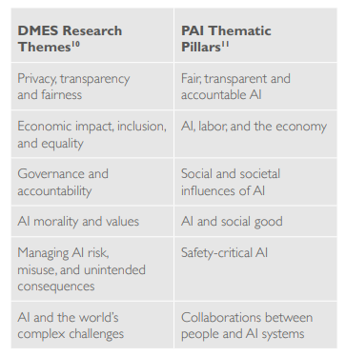
Identifying key concepts and concerns – Ethics
When we look beyond research papers tackling specific issues, towards high-level attempts to synthesize a range of issues, we find many take similar approaches to grouping or categorizing these issues. For example, many similarities can be seen between the categories that DeepMind Ethics and Society (DMES) and the Partnership on AI (PAI) use to define their research areas:

Slide 21
Examples of Tensions between values 1/
Quality of services versus privacy: using personal data may improve public services by tailoring them based on personal characteristics or demographics, but compromise personal privacy because of high data demands.
Personalization versus solidarity: increasing personalization of services and information may bring economic and individual benefits, but risks creating or furthering divisions and undermining community solidarity
Convenience versus dignity: increasing automation and quantification could make lives more convenient, but risks undermining those unquantifiable values and skills that constitute human dignity and individuality.

Slide 22
Examples of Tensions between values 2/
Privacy versus transparency: the need to respect privacy or intellectual property may make it difficult to provide fully satisfying information about an algorithm or the data on which it was trained.
Accuracy versus explainability: the most accurate algorithms may be based on complex methods (such as deep learning), the internal logic of which its developers or users do not fully understand.
Accuracy versus fairness: an algorithm which is most accurate on average may systematically discriminate against a specific minority.
Satisfaction of preferences versus equality: automation and AI could invigorate industries and spearhead new technologies, but also exacerbate exclusion and poverty.
Efficiency versus safety and sustainability: pursuing technological progress as quickly as possible may not leave enough time to ensure that developments are safe, robust and reliable.

Slide 23
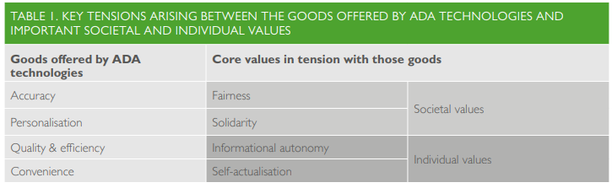
Conflicts with Societal and Individual Values
Note- ADA Technologies imply Algorithm, Data & AI Based Technologies

Slide 24
Stage 1 – Business Scoping Ethics
Informed Consent :
Human Subject must be-
Informed about the experiment
Must consent to the experiment voluntarily
Must have the right to withdraw consent at any time
Impact on Society :
What is the outcome of the data science project, would it have a positive impact on society
Could it lead to taking up human jobs?

Slide 25
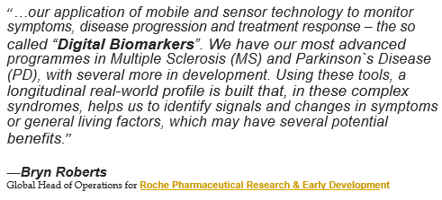
Societal Consequences 1/
AI and Data Science Technology is moving beyond increasing the odds of making a sale, to being used in higher-stakes decisions like medical diagnosis, loan approvals, hiring and crime prevention…
Example: Personalized Healthcare Digital Biomarkers

Slide 26
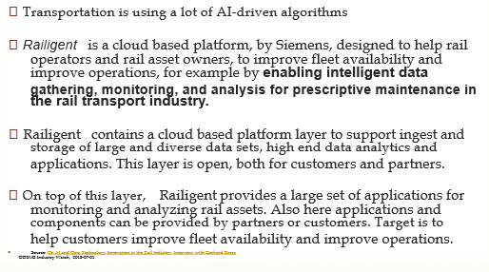
Societal Consequences 2/
Example: Transportation: Railigent
Automate or Augment humans?
You can use AI technologies either to automate or to augment humans.
In the first case, machines replace people, in the second case machine complements people (at least in theory).

Slide 27
Societal Consequences 3/
Implications
When we use Big Data in domains such as healthcare, decisions are practically and ethically very different then marketing and advertising.
These are crucial decisions about individual people’s lives. Better on average isn’t good enough.
For these kinds of decisions, issues of accuracy, fairness and discrimination come into play.

Slide 28
Societal Consequences 4/
New ethical and legal questions
Some AI applications may raise new ethical and legal questions, for example related to liability or potentially biased decision-making.
For example, algorithms are used to review loan applications, recruit new employees and assess potential customers, and if the data are skewed the decisions recommended by such algorithms may be
discriminatory against certain categories or groups.
“What happens if my algorithm is wrong?
Someone sees the wrong ad. What’s the
harm? It’s not a false positive for breast cancer.” -- Claudia Perlich, Data Scientist

Slide 29
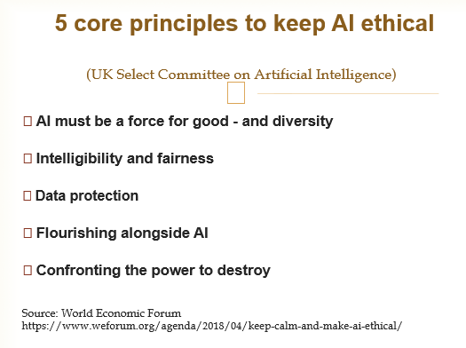
Societal Consequences 5/

Slide 30
Social Consequences 6/
How to Understand Decisions?
At present we do not really understand how Advanced AI- techniques such as used in Deep learning (e.g. neural networks) really works.
This is due to the technical complexity of such advanced neural networks, which need huge amount of data to learn properly. It is a try and error.
This poses an ethical and societal problem:
What if the decision made using AI-driven algorithm harmed somebody, and you cannot explain how the decision was made?

Slide 31
Social Consequences 7/
Automated decision-making
The ability to conscientiously take decisions among alternative possibilities has long been a viewed as a condition that separates man (or at least the living) from machines. As innovations in data science progress in algorithmic trading, self-driving cars, and robotics, the distinction between human and artificial intelligence is becoming increasing difficult to distinguish. Current applications of machine learning cross the threshold of decision support systems and enter the realm of artificial intelligence where sophisticated algorithms are designed to replace human decision-making. Crossing this threshold introduces several ethical considerations.
Can economic and/or social organizations rely on increasingly complex methodologies in which many understand neither the assumptions nor the limits of the underlying models? Are we willing to accept that these applications, which by their very nature, learn from our experience — making us prisoners of our past and limiting our potential for growth and diversity? Do we understand that the inherent logic of these platforms can be gamed — which creates opportunities to “cheat” the system? Last and but not least, who is legally responsible for the implicit bias inherent in automated decision -making?

Slide 32
Accountable AI?
How much Transparency is desired/ possible?
Do we wish “Human in the loop” for most of these kinds of decisions for the foreseeable future?
How is it possible to define incentives for using an ethical approach to software development, especially in the area of AI?

Slide 33
Stage2 -Data Collection Ethical Concerns
Privacy
Confidentiality
Unauthorized
Anonymity
HIPPA Regulations
Proprietary data
Copyright
Data ownership-Data on webpages, PDFs, images etc.
Sources not designed for sharing
Use may violate copyright
Notes:
A critical topic within data science are the ethical issues brought about by
the analysis of data in these formats. Data science is a creative field and
often uses data in ways that it wasn't really intended. So, you get a few
issues that are big. The first of these is privacy. Confidentiality is a major
issue and that's information that shouldn't be shared, even if it's not
anonymous. The reason this is important is because data science often relies
on data sources that weren't designed for sharing.
The second thing in anonymity. The HIPPA regulations have been revised to make
it much harder to identify unique individuals within data. Now, that means if
you're using publicly available data, it may be much closer to anonymous. On
the other hand, proprietary data, where you're working for a client and
they're giving you their own data, that may still have identifiers, and in
that case, the data is no longer anonymous. Anonymity is a major central
element of research ethics and it's something that needs to be considered
carefully.
Another one, and it sort of falls into a different category, is copyright.
Scraping data from websites where you're pulling images or you're pulling text
from a website to get the data from it, this is a common practice. It's
important to know that some of them may violate copyright. If the image or the
text is copyrighted, you could get yourself in some hot water by accessing
that data without permission of the copyright holder. Then I'll finish with a
couple of other things that maybe you haven't considered. One is there's
potential bias.

Slide 34
Privacy
Privacy, of course is the ﬁrst concern that comes to so many minds when we talk about Big Data.
Many app asks for far more permissions that they need
How do we get the value we would like by collecting, linking, and analyzing data, while at the same time avoiding the harms that can occur due to data about us being collected, linked, analyzed, and propagated?
Can we deﬁne reasonable rules that all would agree to?
Can we make these tradeoffs, knowing that maintaining anonymity is very hard?
People have different privacy boundaries. As society adapt to new technologies, attitude change
But different boundaries doesn’t mean no boundary

Slide 35
Privacy in Research Data
Advancements in data science & data exchange & social changes … meet scholarly communication
Increased publication of data & data deposit mandates
Privacy relevant in STM but concerns also present in HSS
Data does not contain PII but could if data set is combined with related data sets
Data that is historical in nature contains PII
Data from back-end usage of systems and policies regarding tracking of researcher behavior
Security of data replication and interaction with other systems
Privacy metadata about the data set

Slide 36
Privacy – More Issues
When is privacy about a community, not just an individual?
Replication is not being evaluated
Reuse restrictions
Longitudinal consent
Ethical but not legal responsibilities
Library repositories will not take PII
“Privacy is a footnote in the policy world and OA Movement. It’s being left to the local community”

Slide 37
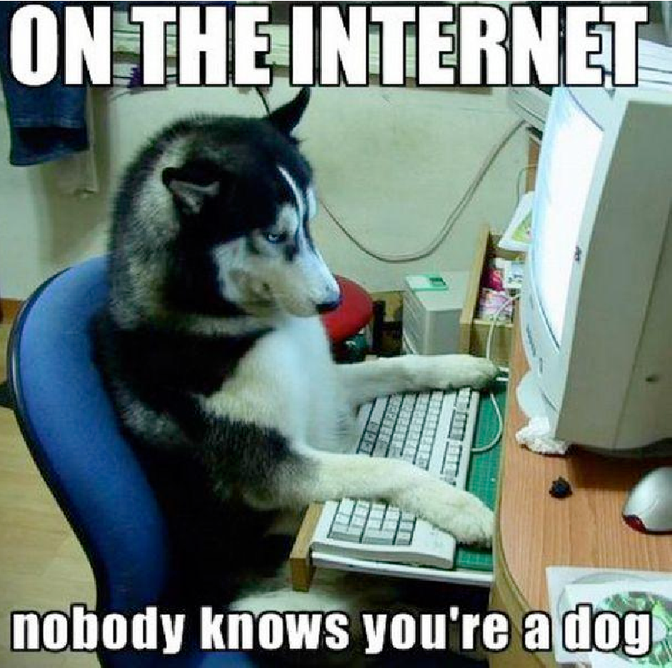
Anonymity
On the internet, nobody knows you are a dog
You can say whoever you are?
You can say whatever you are?
You can make up a persona?
But today, we ﬁnd it less and less true

Slide 38
Anonymity Breaches
Many transactions need ID
You must provide an address to receive goods
You must give your name for travel booking
You must reveal your location to get cellular service
You must disclose intimate details of your health care and lifestyle to get effective medical care
Facebook real name policy
Enough history tells all
Search pattern for person can reveal your identity
If we have a log of all your web searches over some period, we can form a very good idea of who you are, and quite likely identify you
De-identiﬁcation
Given zip code, birth date and sex, about 87% of Social Security Numbers can be determined uniquely
Those three ﬁelds are usually not considered PII (Personally Identiﬁable Information)
Netﬂix Prize
User_ID, Movie, Ratings, Date
Merge with data from IMDb
With only a few ratings, user could be linked across the two systems
Their movie choices could be used to determined sexual orientation, even if all their IMDb reviews revealed no such information
Bad already for only movie recommendation, so what about medical records

Slide 39
Anonymity - Concerns
Four Types of Leakage
Reveal identity
Reveal value hidden attribute
Reveal link between two entities
Reveal group membership
Anonymity is Impossible
Anonymity is virtually impossible, with enough other data
Diversity of entity sets can be eliminated through joining external data
Aggregation works only if there is no known structure among entities aggregated
Face can be recognized in image data
Should we prevent sharing data ?
If anonymity is not possible, the simplest way to prevent misuse is not to publish the dataset
E.g. government agencies should not make public
Yes access to data is crucial for many desirable purposes – Medical data, Public watchdog

Slide 40
Data Ownership
Most of the time you don’t own the data about you. The data belongs to the company who collected it?
Nevertheless we might have some control over these data that aren’t ours because they are about us
We need to create the principle to reason about this control and that’s the main concern of a discussion about the right to privacy
If the company goes bankrupt, the company buying it should keep the same privacy

Slide 41
Ethics implications of Web Scraping
The Ethical Scraper: will live by the following principles:
If you have a public API that provides the data I’m looking for, I’ll use it and avoid scraping all together.
I will always provide a User Agent string that makes my intentions clear and provides a way for you to contact me with questions or concerns.
I will request data at a reasonable rate. I will strive to never be confused for a DDoS attack.
I will only save the data I absolutely need from your page. If all I need it OpenGraph meta-data, that’s all I’ll keep.
I will respect any content I do keep. I’ll never pass it off as my own.
I will look for ways to return value to you. Maybe I can drive some (real) traffic to your site or credit you in an article or post.
I will respond in a timely fashion to your outreach and work with you towards a resolution.
I will scrape for the purpose of creating new value from the data, not to duplicate it.

Slide 42
The Ethical Site Owner
- For Web Scrapping
I, the site owner will live by the following principles:
I will allow ethical scrapers to access my site as long as they are not a burden on my site’s performance.
I will respect transparent User Agent strings rather than blocking them and encouraging use of scrapers masked as human visitors.
I will reach out to the owner of the scraper (thanks to their ethical User Agent string) before blocking permanently. A temporary block is acceptable in the case of site performance or ethical concerns.
I understand that scrapers are a reality of the open web.
I will consider public APIs to provide data as an alternative to scrapers.

Slide 43
Ethics Measures in Data Collection & Storage
Data citizens
Perhaps no area of ethics in data science has received more attention today than the protection of personal data. The digital transformation of our interactions with social and economics communities reveals who we are, what we think, and what we do.
The recent introduction of legislation in Europe (GDPR), India (the Personal Data Protection Act, 2018)., and California (the California Consumer Privacy Act of 2018) specifically recognize the rights of digital citizens, and implicitly address the dangers of the commercial use of personal and personally identifiable data.
These legal frameworks try to rebalance the inequitable relationships of power and influence between organizations and individuals in codifying ethical benchmarks including the right to be informed, the right to object, the right of access, the right to rectification, and the right to be forgotten.
The attention given to this legislation extends far beyond concerns for data protection. These attempts to define proper and illicit data practices respond to a number of ethical questions. As data become the new currency of the world economy, the lines between public and private, between individuals and society, and between the resource rich and the resource poor are being redrawn.

Slide 44
Ethics Measures in Data Collection & Storage contd..
Distributed ledgers
Distributed ledger technologies in general, and blockchain technologies in particular, offer their share of hope both for a more transparent and traceable source of information. Yet this vision of an Internet of Value is partially clouded by the potential societal challenges of relatively untested technologies. Can technology in and of itself be the standard for both truth and trust?

Slide 45
Stage 3 – Data Preparation Ethic Concerns - Data Validity
Bad Data and Bad Models lead to bad decisions
If decision making is opaque, results can be bad in the aggregate, and catastrophic for an individual
What if someone has a loan denied because of an error in the data analyzed
Sources of Error
Choice of representative sample
Choice of attributes and measures
Errors in the Data
Errors in Model Design
Errors in Data Processing
Managing change

Slide 46
Data Processing
Data Processing Errors
Wrong entry for example
Bug in code
Managing Change
System change continuously
Is analysis still valid?
Most changes may not impact analysis
But some do and we might not know which one
Famous case of “Google Flu”
Predictor worked beautifully for a while
Then crashed

Slide 47
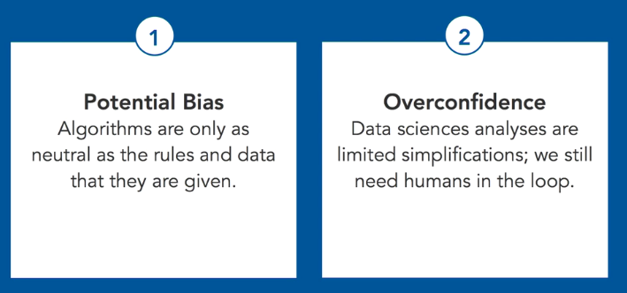
Stage 4 – Data Science Algorithms – Ethical Issues
Notes:
The algorithms that are used in data science, of course, are value neutral in and of themselves. They don't have opinions. But the algorithms are only as neutral as the rules and the data that they are given by the programmers. The second thing is overconfidence. Data science analyses are limited simplifications. Every analysis is a simplification. You still need humans in the loop. You have the problem of people believing that if it came through a machine learning algorithm, it must be the truth, it must be the right thing, without realizing both the bias and the problems of interpretation that still result.
People are still needed here. So, our conclusions are that data science has potential and it has risks. We knew that. Importantly, analyses are not value neutral and that personal human judgment is always needed in the planning, the carrying out, and the interpretation of the results of data science projects.

Slide 48
Bias
Statistical bias is a feature of a statistical technique or of its results whereby the expected value of the results differs from the true underlying quantitative parameter being estimated. The bias of an estimator of a parameter should not be confused with its degree of precision as the degree of precision is a measure of the sampling error.
Types –
Selection Bias
Reporting Bias
Exclusion Bias

Slide 49
Stage 4 – Data Model Design Errors
Ending up with invalid conclusions even with perfect
inputs, perfect data going in…
1. Many ways model could be incorrect
Model structure and Extrapolation
Feature Selection
Ecological Fallacy
Simpson’s Paradox
2. Model Structure and Extrapolation
Most machine learning model just estimates parameters to ﬁt a pre-determined model
Do you know the model is appropriate ?
Are you trying to ﬁt a linear model to a complex non-linear reality ? Or the opposite ?

Slide 50
Stage 4 – Data Model Design Errors
Feature selection
Did you know that taller people are more likely to
grow beards?
Women are generally shorter, They don’t grow beards
Ecological Fallacy
Analyzing results for a group and assign results to individual
Districts with higher income have lower crime rates
=> richer individual less likely to be a criminal

Slide 51
Algorithmic Fairness
Can algorithm be biased?
Can we make algorithms unbiased?
Is training data set representative of the population?
Is past population representative of future population?
Are observed correlations due to confounding processes?

Slide 52

Example: Algorithmic
Vicious Cycle
• Company has only 10% women employees
• Company has “‘boys’ club culture” that makes it
difﬁcult for women to succeed
• Hiring algorithm trained on current data, based on
current employee success, scores women
candidates lower
• Company ends up hiring fewer women
72

Slide 53
Racial Discrimination
• Universities prohibited by law from considering
race in admission
• Can ﬁnd surrogate features that get them close,
without violating the law
• Lender prohibited by law from redlining on race
• Can ﬁnd surrogate features
• In general, proxy can be found
74

Slide 54
Discrimination Intent
• Big Data provides the technology to facilitate such
proxy discrimination
• Whether this technology is used this way becomes
a matter of intent
• It also provides the technology to detect and
address discrimination
75

Slide 55
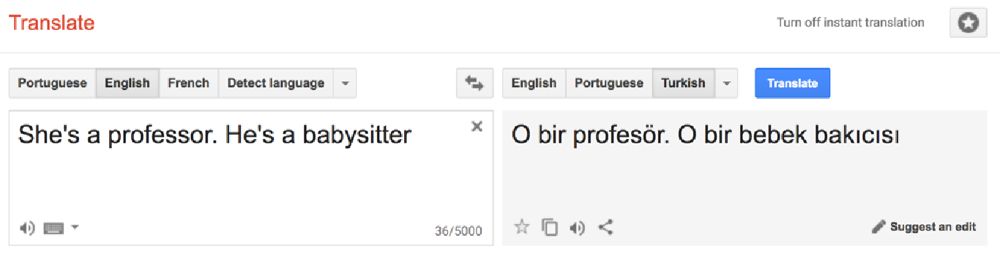
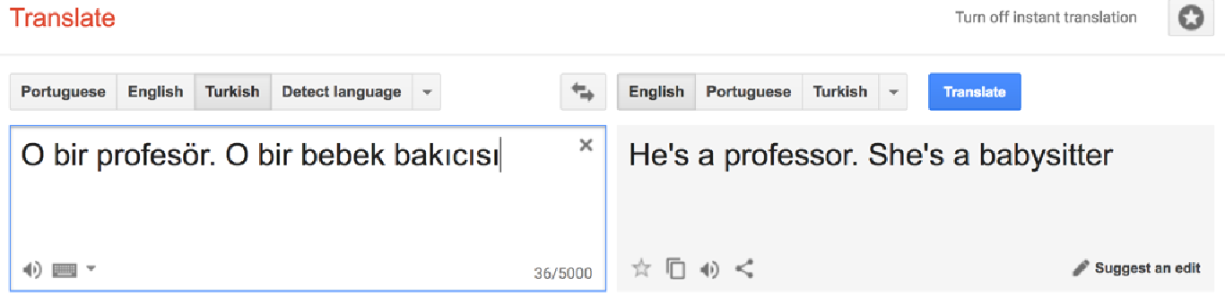
Unintentional Discrimination
77
https://www.youtube.com/watch?v=hDgXIUM3Rmw

Slide 56
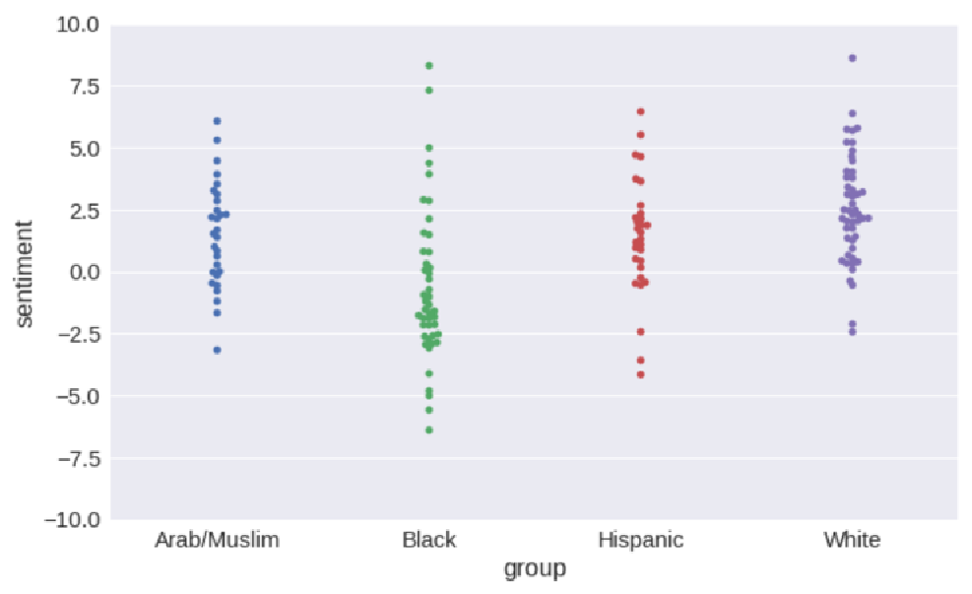
Unintentional Discrimination
https://blog.conceptnet.io/2017/07/13/how-to-make-a-racist-ai-without-really-trying/
81

Slide 57
Diversity Suppression
(Hiring)
• Use Data Science to ﬁnd promising prospects
• Criteria are tuned to ﬁt the majority
• Algorithm performs poorly on (some) minorities
• Best minority applicants are not hired
97

Slide 58
P-Value Hacking
• Please read extensively about it before reporting
any result saying that your experiment has a p
value < 0.05
• Standard p-value mathematics was developed for
traditional experimental techniques where you
design the experiment ﬁrst and then collect the
data
99

Slide 59
Algorithmic Fairness
Conlusion
• Human have many biases
No human is perfectly fair even with the best of
intentions and biases are hard to detect
sometime
• Biases in algorithms usually easier to measure,
even if outcome is no fairer
100

Slide 60
Stage 5 – Ethics in Data Visualization
Use uniform scale, zero for scale appropriately set
Use colors appropriately, if they indicate meaningful information
Direction and position of axis is important

Slide 61
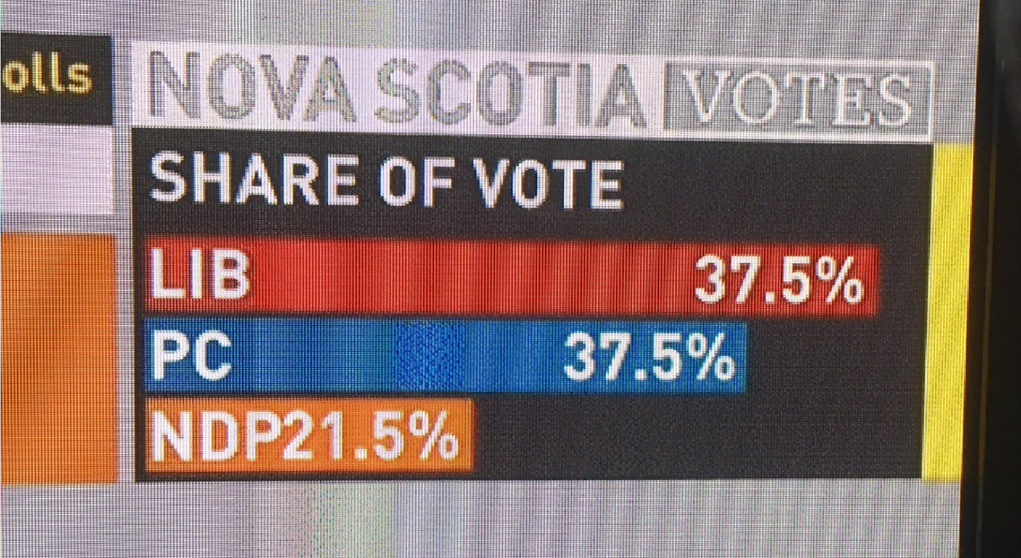
Correct but Misleading
Results: Visualisation edition
89
http://viz.wtf/

Slide 62
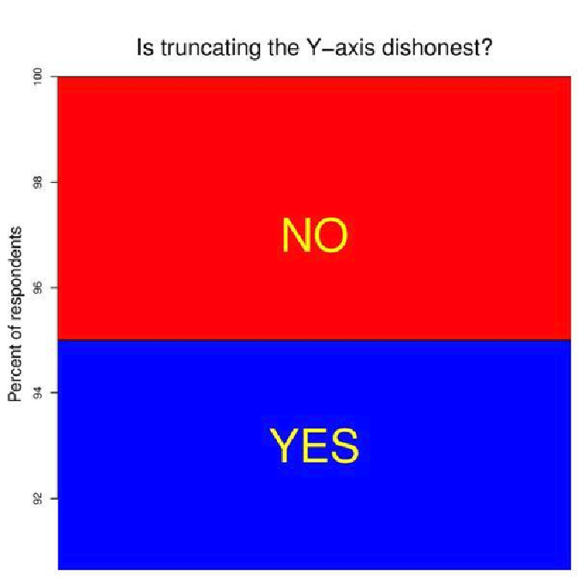
Correct but Misleading
Results: Visualisation edition
90

Slide 63
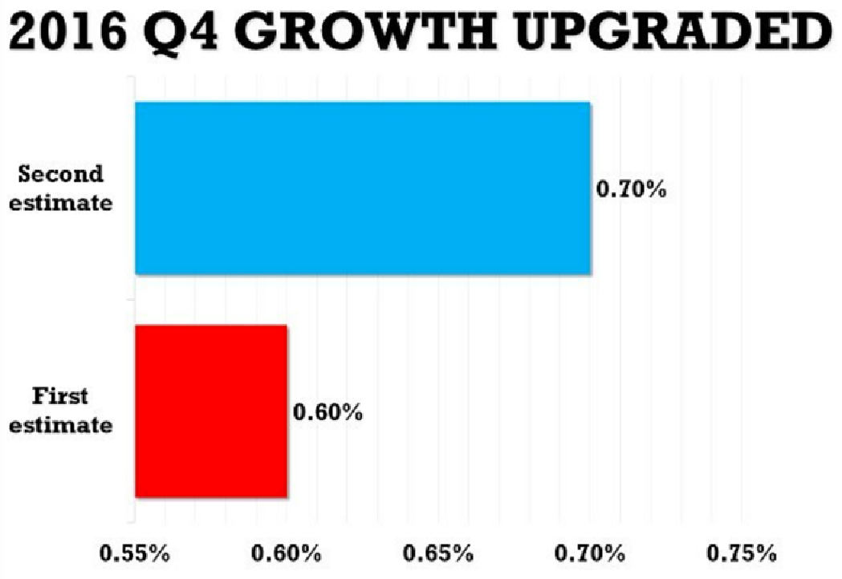
Correct but Misleading
Results: Visualisation edition
88
http://viz.wtf/

Slide 64
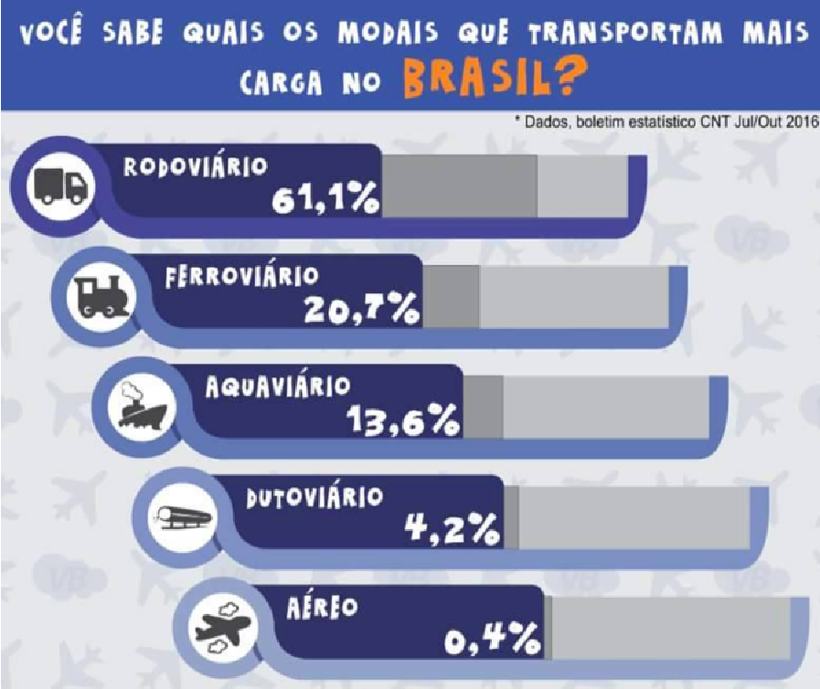
Correct but Misleading
Results: Visualisation edition
86
http://viz.wtf/

Slide 65
Conclusion: Ethics Matter
• Data Science has great power — to harm or to help
• Data Scientists must care about how this power is
used
• Cannot hide behind a claim of “neutral
technology”
• We are all better off if we voluntarily limit how this
power is used
106

Slide 66
References
https://www.slideshare.net/HJvanVeen/ethics-in-data-science-and-machine-learning
https://wiki.diglib.org/images/1/1a/ERN-Data-Ethics.pptx
https://www.lynda.com/Big-Data-tutorials/Ethical-issues/420305/505117-4.html
https://towardsdatascience.com/the-ethics-of-data-science-e3b1828affa2
https://www.nuffieldfoundation.org/sites/default/files/files/Ethical-and-Societal-Implications-of-Data-and-AI-report-Nuffield-Foundat.pdf
https://towardsdatascience.com/ethics-in-web-scraping-b96b18136f01
https://www.researchgate.net/publication/324907302_Legality_and_Ethics_of_Web_Scraping
Case Studies –
https://datasociety.net/blog/2016/04/13/data-ethics-case-studies/
https://www.oreilly.com/ideas/case-studies-in-data-ethics
https://aiethics.princeton.edu/case-studies/
Practice questions –
https://towardsdatascience.com/notes-and-technical-questions-from-interviewing-as-a-data-scientist-in-2018-20e7e3ee4ab3
https://www.dezyre.com/article/100-data-science-interview-questions-and-answers-general-for-2018/184

Slide 67
P-Value
What Is P-Value?
The p-value is the level of marginal significance within a statistical hypothesis test representing the probability of the occurrence of a given event. The p-value is used as an alternative to rejection points to provide the smallest level of significance at which the null hypothesis would be rejected. A smaller p-value means that there is stronger evidence in favor of the alternative hypothesis.
https://www.investopedia.com/terms/p/p-value.asp

